Slide 1
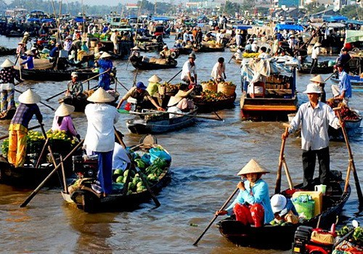
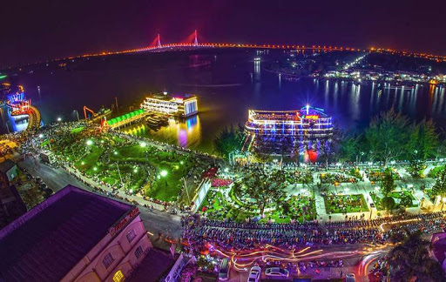




Can Tho City Climate Action
Draft Results as of November 2020

Slide 2
Background
About the City

Slide 3
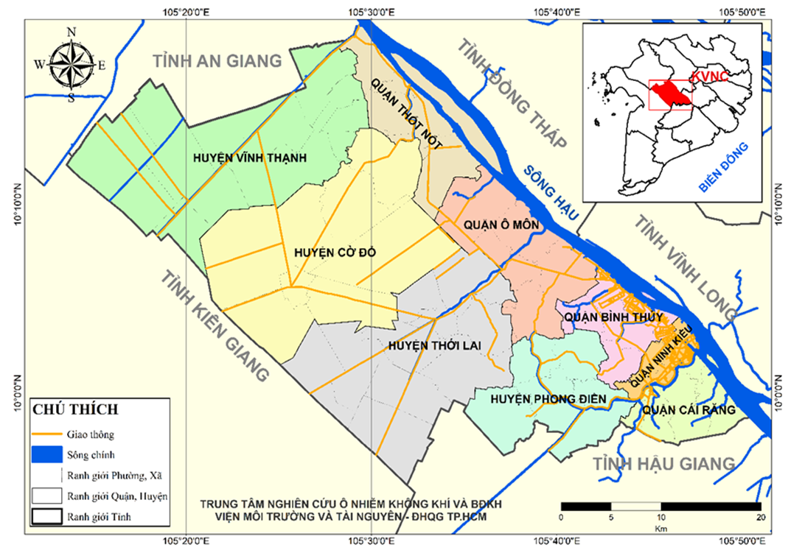
Can Tho City
Area: 1.439km²
Population: 1.235.954 người
Polulation density 859 người/km²
(Can Tho Statistical Yearbook, 2019)

Slide 4
Climate Change Vulnerability and Risk Assessment

Slide 5
Index of Land-use and Population Database
Adaptive Capacity
Sensitivity
Exposure
Hazards
Population Literacy Rate
Employed Population
%Access to flood mitigation infrastructure
% HH with access to information)
% HH with Access to Sanitary Toilet
Capacity of government to make investments in CCA-DRR
% Affected HH living in semi-permanent, un-permanent, simple houses
% Female population
% Young Population
Old Population (65 and over)
% HH below the Poverty Threshold
% HH Living without access to safe/clean water
Affected population
Affected areas
Impacted asset
Likelihood of Occurrence
Vulnerability
Severity of Consequence Score
RISK SCORE

Slide 6
Index of Infrastructure Database
Adaptive Capacity
Sensitivity
Exposure
Hazards
City Regulations on hazard mitigation (e.g. zoning, structural design standards, etc)
City has financial Resources to invest for DRR and CCA
Damage from previous hazard events
Impacts to industry and livelihood (estimated % loss when affected by hazards)
Affected Length (Linear Kilometer)
Average Affected Value (VND)
Likelihood of Occurrence
Vulnerability
Severity of Consequence Score
RISK SCORE

Slide 7
Targets and Objectives
For Mitigation and Adaptation

Slide 8
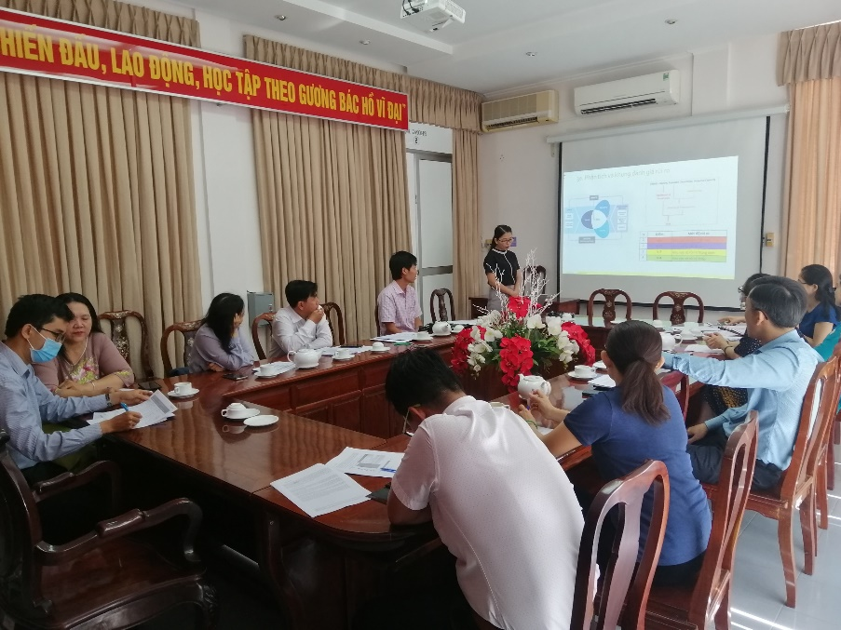
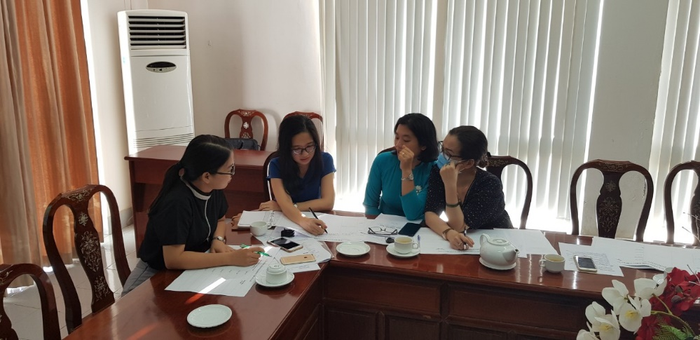
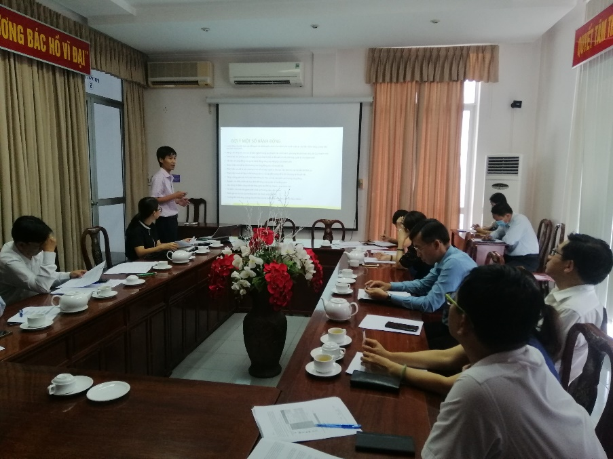
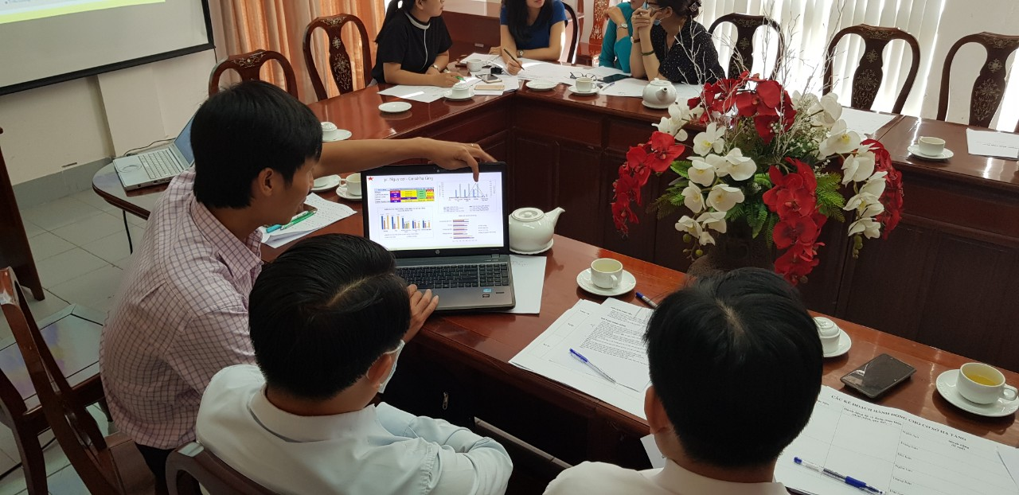
Meeting with a group of local agencies in Can Tho city
Discussed about CRVA
Discussed about GHG inventory
Discussed about targets and proposed actions

Slide 9
Adaptation Goals
Guiding Question for the Workshop:
Considering the findings, what goal should we have
Elements at Risk | Adaptation Goals/Objectives | Some Considerations
Population | Effective adaptation to flood risk and Enhance adaptive capacity for the governmental agencies and the local communities | Who will be the focus? Local agencies and communities What Area? # or % to be targeted Flood: the central area, salinity: the South of the city, Riverbank erosion: O Mon, PĐ, BT.
Infrastructure | 1. Development of blue-green infrastructure 2. Early warning systems for natural disaster reduction | Type of Infrastructure that will be prioritized? - The drainage water systems - The water supply system
Land Use | Effective land use planning and management approved land-use plan by a competent state agency | What Land Use requires particular attention? The residential/political/commercial/industrial areas

Slide 10
Mitigation Target
Guiding Question for the Workshop:
Considering the findings, what target should we have?
Sectors and Sub-sectors | Total
Stationary > Residential | 813,254
Stationary > Commercial | 194,013
Stationary > Industrial | 2,058,995
Stationary > Agriculture | 64,842
Transportation > On-road | 516,340
Waste > Solid waste disposal | 152,151
Waste > Wastewater | 217,178
“Can Tho Mitigation Target will be based on the PIPA and consistent with the Viet Nam updated NDC which targets about 9% compared to BAU by 2030 with domestic resources, and 27% with international support”
“The city mitigation target in the CAP is subject to deliberation and approval of the CTC People’s Committee”

Slide 11
6. Priority Adaptation Actions
Strategies/Projects/Activities

Slide 12

Population: Reducing Vulnerabilities and Managing Risks
CVRA Findings/Issues
Proposed Actions
(with specific targets)
 | Planned actions
 | Short-term | Mid-term | Long-term
Flood | Building capacity to adapt with flood. Protection the natural canals within core area of the city | Completing the constructions for flood prevention from the WB project. Planning flood prevention for others sub-urban | Implement the general measures at the delta scale
River bank erosion | Building capacity for emergency response | Invest dyke construction at the vulnerable locations
Salinity intrusion | 1. Enhance management agencies and community respond to salinity | 1. Invest for a complete salinity monitoring and early warning system | 1. Use desalination technology 2. Change water source locations to mitigate salt.
High tide | Building a early warning for high tide to reduce its consequences | Improve the transportation system adapting with high-tide | Consider for the measure at the delta scale
12
12/16/2020
Add a footer

Slide 13

Infrastructure: Reducing Vulnerabilities and Managing Risks
CVRA Findings/Issues
Proposed Actions
(with specific targets)
 | Planned actions
 | Short-term | Mid-term | Long-term
Flood | 1. Enhance adaptation activities in production and livelihood to flood. | 1. Development on Blue-Green infrastructure constructions | Improve water drainage network. Change house design
River bank erosion | 1. Resettle vulnerable communities | 1. Construct river embankment
Salinity intrusion | Enhance the existing monitoring and warning. Prepare a plan for water supply security in urgent case. | Early warning system Develop a adaptive agriculture production (adaptive varieties, cultivation…). Adaptive water supply security. | 1. Use desalination technology

Slide 14
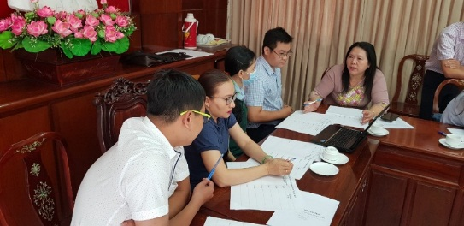
Land-use: Reducing Vulnerabilities and Managing Risks
CVRA Findings/Issues
Proposed Actions
(with specific targets)
 | Planned actions
 | Short-term | Mid-term | Long-term
Flood | 1. Strengthen land use plan implementation | 1. Research and design synchronized plan | 1. Integrated regional development.
River bank erosion | 1. Strengthen embankment construction supervision, management and maintenance | 1. Plant native trees and shrubs along the banks | 1. Inter-provincial coordination against sand exploitation 2. Alternative materials without sand.
Salinity intrusion | 1. Use tolerance plants | 1. Take research results into account | 1. Internationally water cooperation
High tide | 1. Improve water drainage conduits | 1. Raise community awareness | 1. Invest for a dyke system

Slide 15
THANK YOU
for your attention

